Slide 1
Kingdom vs. Republic
Kingdom: a state or government having a king or queen as its head.
Republic: a state in which the supreme power rests in the body of citizens entitled to vote and is exercised by representatives chosen directly or indirectly by them.
From Latin res (thing) + publica (public)

Slide 2
Outline
The Roman Kingdom
Overthrow of the Kings
Constitution and Institutions of the Republic

Slide 3
Roman Kings
Romulus
Numa Pompilius
Tullus Hostilius
Ancus Marcius
Tarquinius Priscus
Servius Tullius
Tarquinius Superbus

Slide 4
King Romulus
The Sabine women
Origin of the term ‘Quirites’ (from Cures)
Wars with neighboring cities, including those of the Sabines and Etruscans
Disappeared in a thunderstorm?
Torn apart by senators?
Deified? (so says Proculus Iulius)

Slide 5
Numa Pompilius
Sabine from Cures and supposed pupil of Pythagoras
Elected successor to Romulus
Supposed created the 12 month calendar, established numerous priesthoods, and founded the temple of Janus

Slide 6
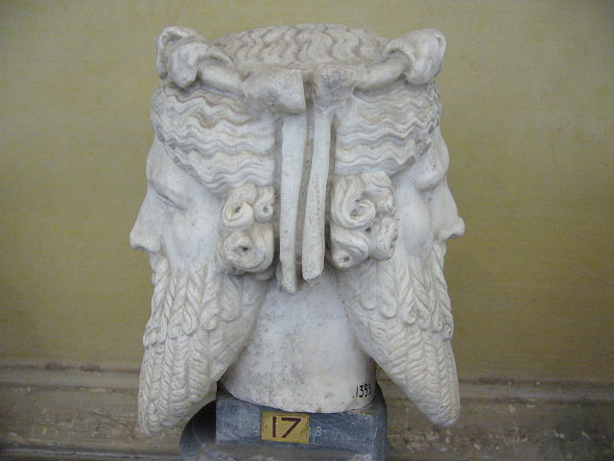
SIDEBAR: Janus
God of archways, doorways, beginnings and endings
January named after him
Usually first god invoked
Temple doors left open in times of war
Priests of Janus were ‘doorkeepers’ or ‘Janitors’

Slide 7
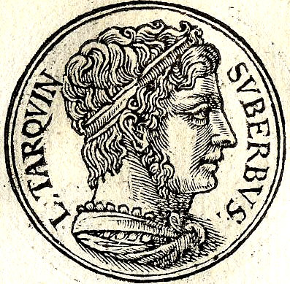
Tarquinius Superbus
Son or grandson of Tarquinius Priscus (5th king of Rome)
Married Tullia, daughter of Servius Tullius (6th king of Rome)
Overthrew Servius to become 7th king of Rome
Superbus = ‘proud’

Slide 8
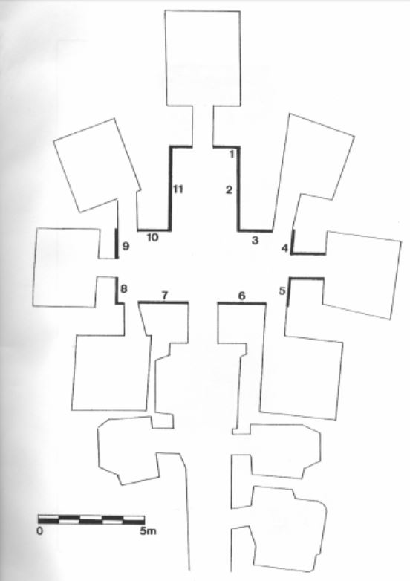
François Tomb
Etruscan tomb near Vulci in northern Etruria
Discovered in 1857
c. 350-300 BCE
Paintings showing mythical and historical (?) scenes
Figures labelled

Slide 9
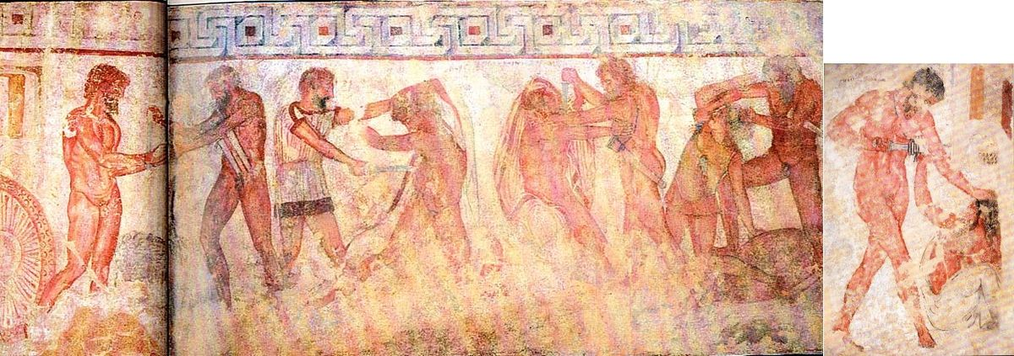
François Tomb
*
Mastarna
= Servius Tullius?
Gnaeus Tarquinius of Rome?
Caelius Vibenna
Marcus Camillus

Slide 10
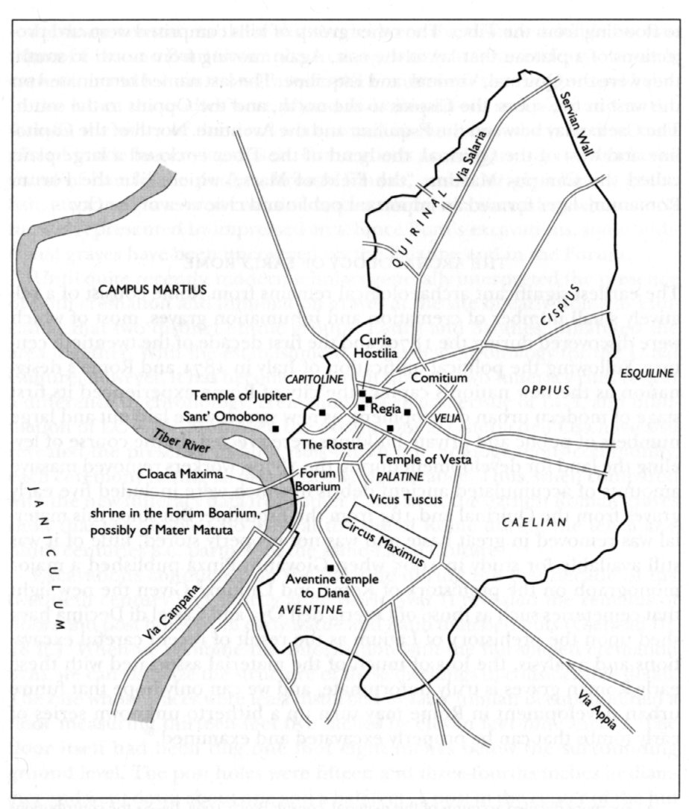
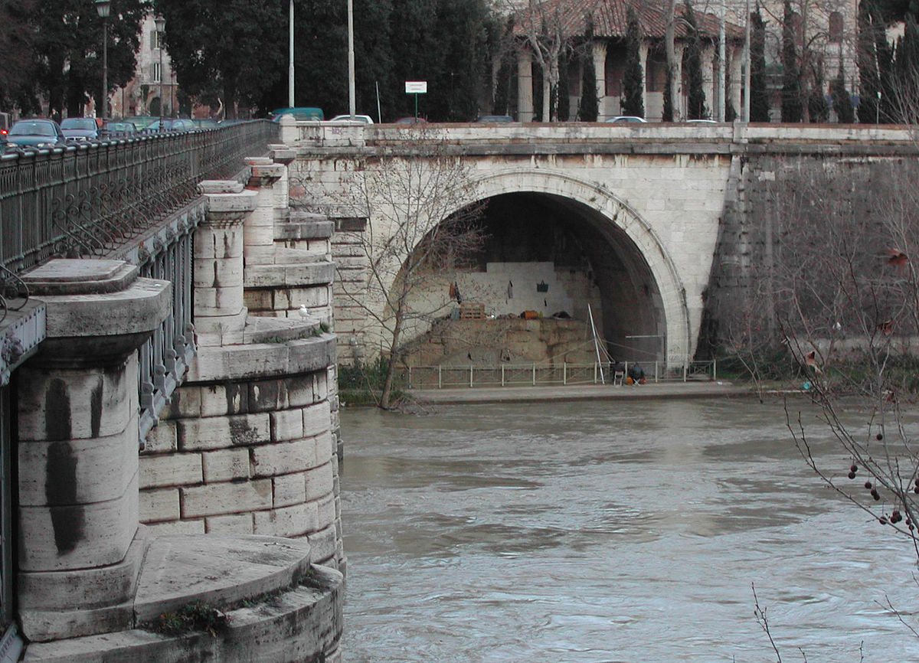
(Supposed) Building Projects
Cloaca Maxima drain on the Tiber

Slide 11
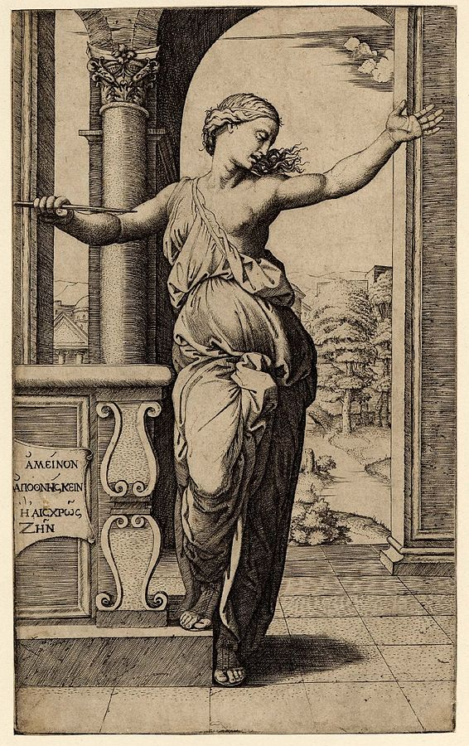
Lucretia
Sextus Tarquinius, son of Tarquinius Superbus
Raped Lucretia, wife of his friend Collatinus
Lucretia told what happened and killed herself in front of witnesses
Including her uncle Lucius Iunius Brutus
Engraving of Lucretia by Marcantonio Raimondi (1534)

Slide 12
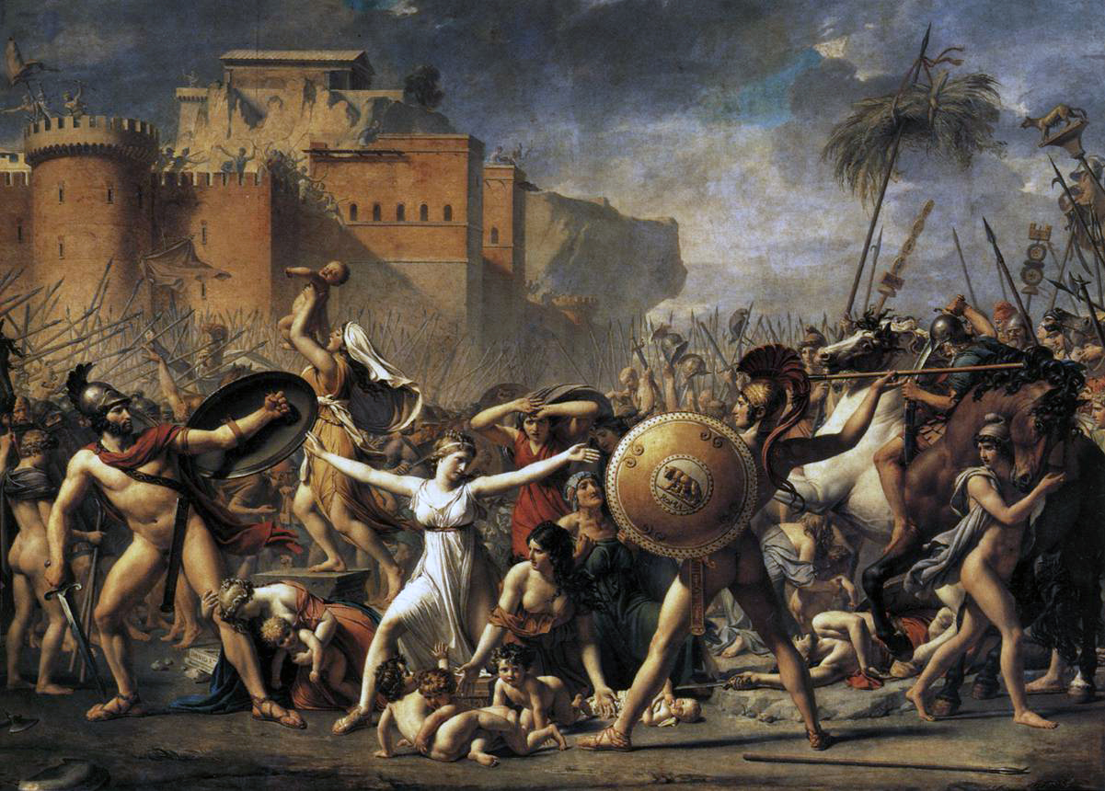
The Sabine Women and Lucretia
Jean-Louis David, The Intervention of the Sabine Women (1799)

Slide 13
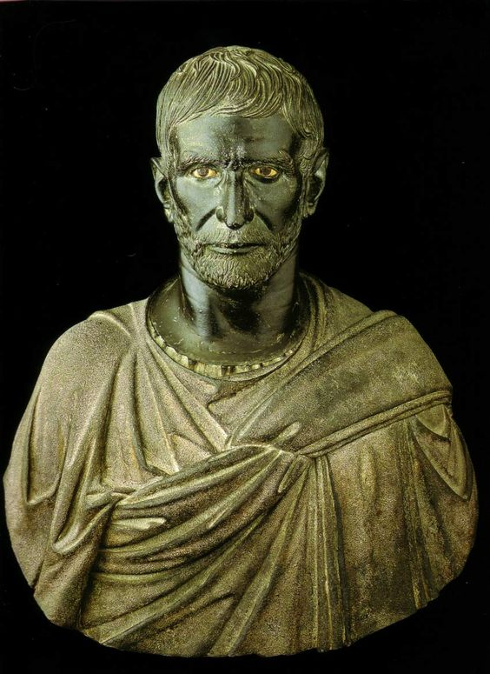
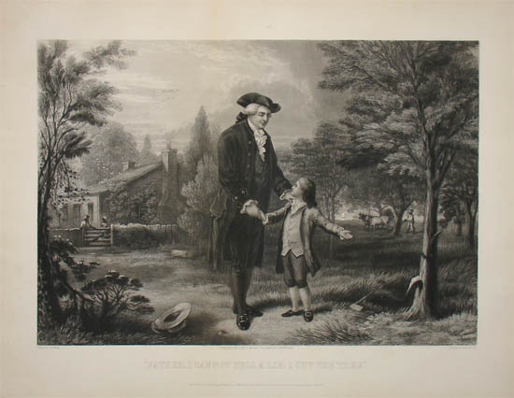
Lucius Iunius Brutus
Brutus = ‘stupid’
Supposedly his father and brother were killed by Tarquinius Superbus
Roused the Romans against Tarquinius and forced him into exile
Established the republic in 509 BCE (the Romans believed)
Capitoline ‘Brutus,’ c. 300 BCE

Slide 14
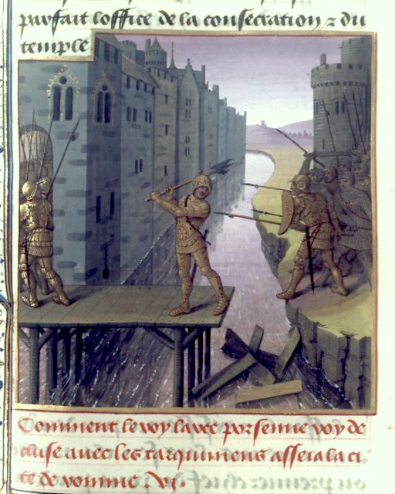
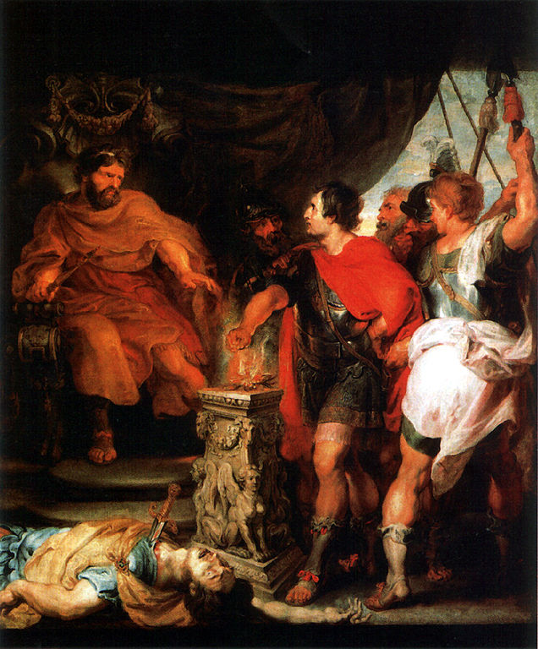
More Heroes of the Republic
Horatius Cocles
Gaius Mucius Scaevola
Mucius Scaevola and Lars Porsenna
Horatius at the bridge

Slide 15
History or Myth?
Is it plausible?
How would Romans of Livy’s day have known this information?
Is it teleological (does it explain the present instead of the past)?
Are the details specific or stereotypical?
And how does it compare to other evidence…

Slide 16
Roman Social Orders
Patricians
Descendants of Romulus’ original 100 senators
Equestrians/Knights
Descendants of Servius Tullius’ original cavalry centuries
Consisted of those who could afford to maintain horses
Plebeians/Plebs
All other citizens

Slide 17
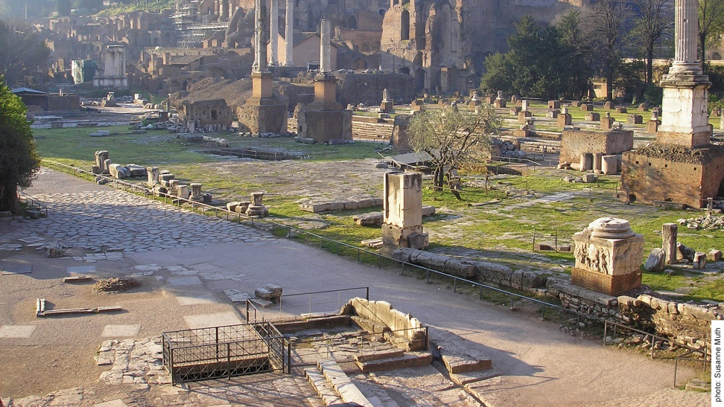
Comitia
Citizen assemblies for the purpose of voting
Met in the Comitium
Supposed established by Servius Tullius
Voted by century (i.e. in blocs)
Majority of centuries were elite
Elite centuries voted first
So elite votes counted more
Site of the Comitium in Rome

Slide 18
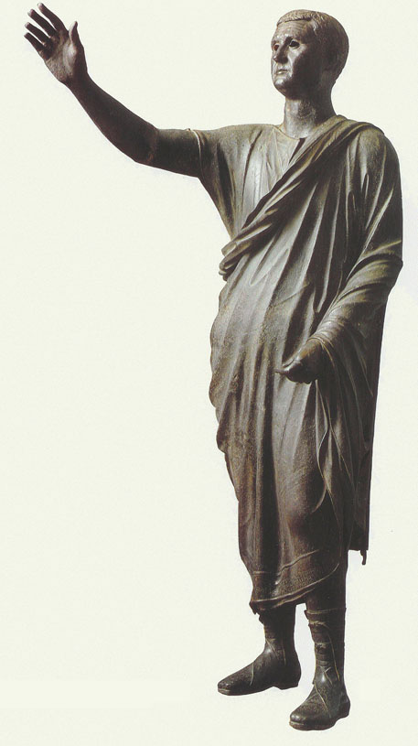
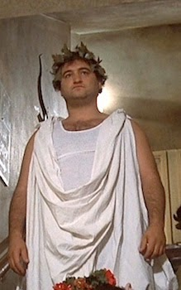
Toga!
Wool garment worn by Roman citizens
3.5 m long! (i.e. over 11 feet!)
Worn without pins (i.e. wrapped around the body)
Children and magistrates wore toga praetexta with a purple stripe
Candidates for office wore the toga candida, the ‘bright white toga’

Slide 19
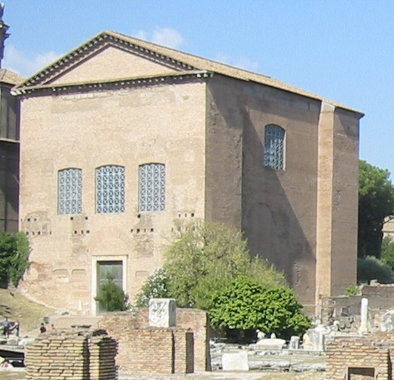
The Senate
From senex = ‘old man’
Believed to have been founded by Romulus
Originally an advisory body
Former magistrates became senators
Usually had to approve laws before they could be voted on by the assembly
Met in the Curia
The Curia Julia as restored in the 1930s

Slide 20
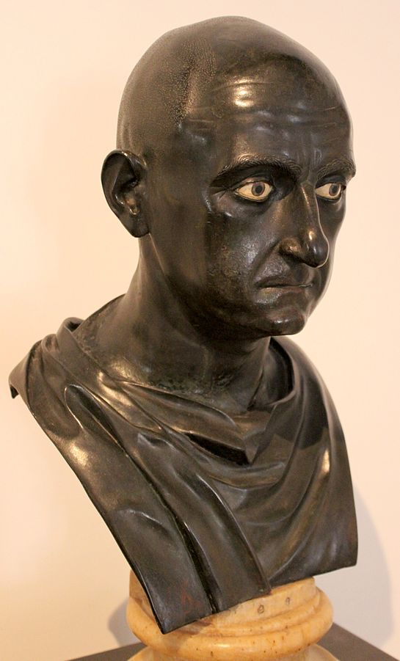
Consuls
Highest ranking Roman magistrates
Two served at a time, for one year terms
Elected by the comitia
Had imperium – right of military command outside of Rome
Only patricians allowed until 367 BCE
Publius Cornelius Scipio Africanus
c. mid 1st cen. BCE

Slide 21
Tribunes
Elected officers of the plebs
Sworn to protect the plebs against abusive magistrates
In return the plebs swore to protect the tribunes
Had veto power over the senate

Slide 22
Twelve Tables
First Roman law code
Proposed in 462 by the tribune C. Terentilius Arsa
Finally drawn up in 451-450 by ten patricians
Inscribed on tablets and set up in the Forum
Tables no longer survive

Slide 23
Other Magistrates
Praetors
Supreme legal authorities in Rome
Quaestors
Responsible for finance
Aediles
Responsible for administration of Rome
Censors
Maintained senate enrollment and monitored senators’ morals

Slide 24
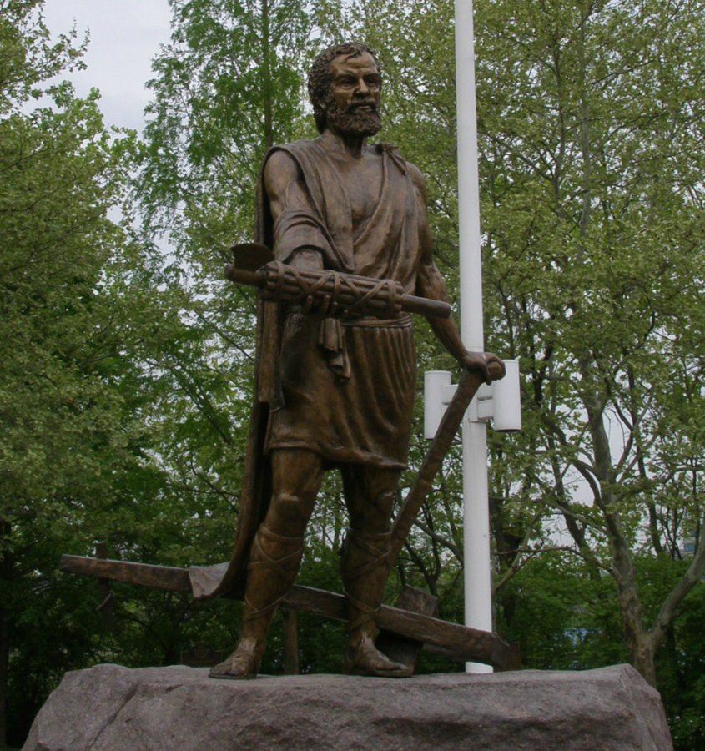
Dictators
Supreme military commander appointed in times of crisis
Nominated by consuls
Served six month term
Appointed own deputy
‘Master of horse’
Lucius Quinctius Cincinnatus
Appointed dictator in 458 BCE
Left his farm and took command of the army
Resigned the dictatorship 15 days later
Lucius Quinctius Cincinnatus statue, Cincinnati, OH

Slide 25
Key Terms
Sabine women
Quirites
Numa
Tarquinius Superbus
Cloaca Maxima
Lucretia
Lucius Junius Brutus
Patricians
Equestrians
Plebeians
Senate
Consuls
Tribunes
Twelve Tables
Dictators

